Slide 1


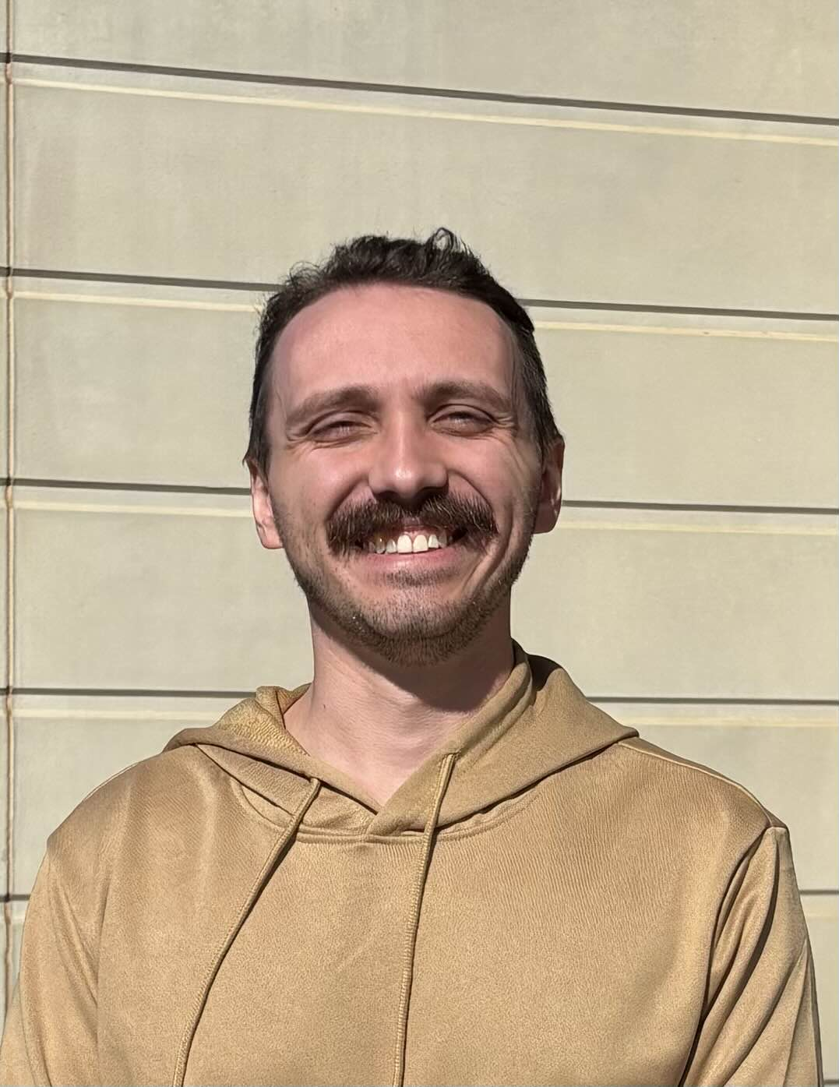
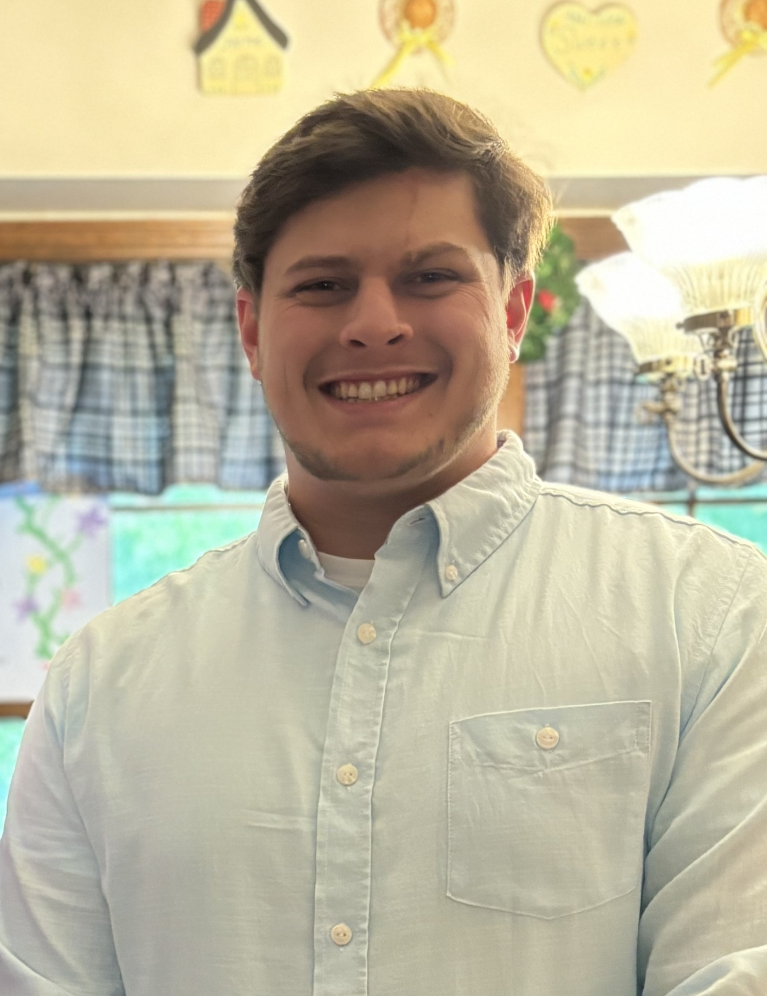
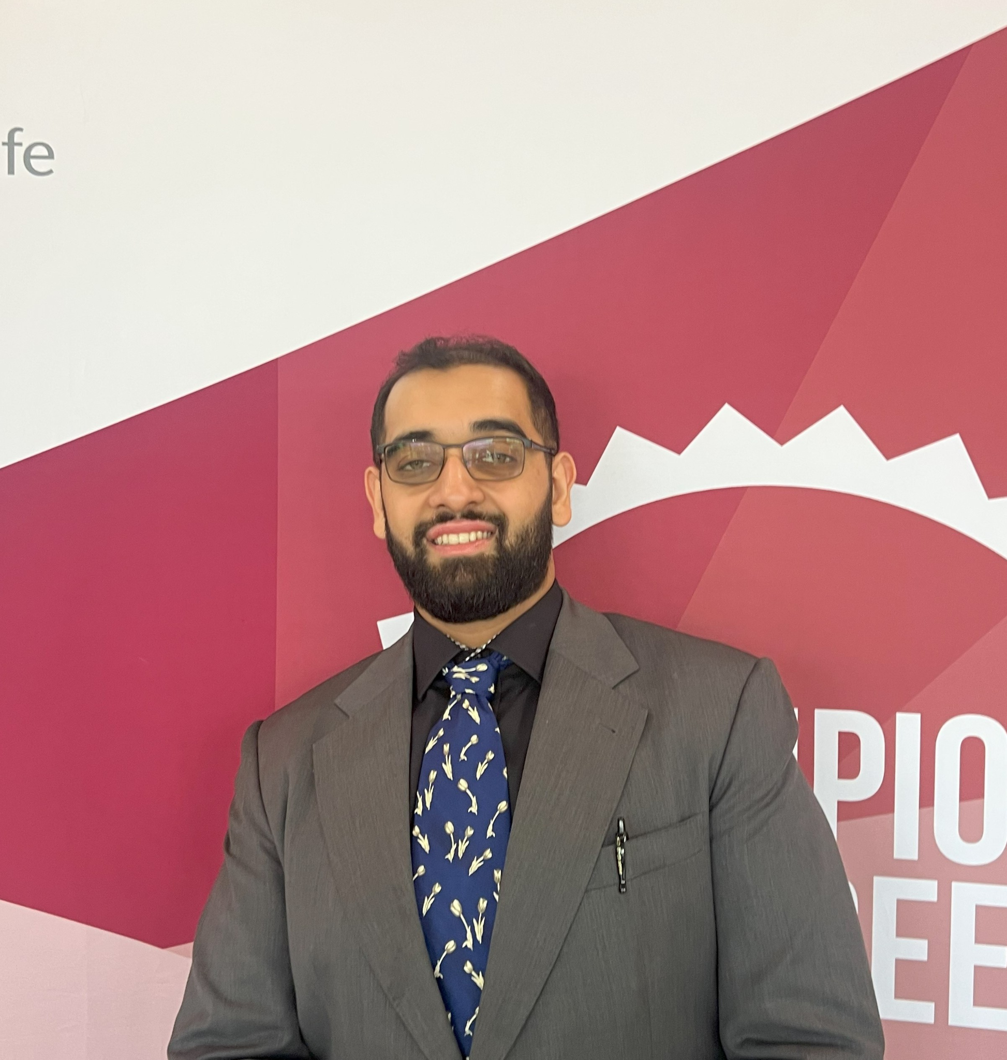

Application to Collect Images for Motion Products
Sprint 3
Project Website: https://lilbob0506.github.io/MotionProducts/
Source Code Website: https://github.com/LilBob0506/MotionProducts
Hamza Adnan | Sammy Allen | Hunter Reinhart | Shan Sahib | Drew Wolfe

Slide 2

Overview/Recap
Motion.com is a website used to sell industrial products for the company motion. Of the ~12 million products on their website, they only have images for ~1 million of them. Our goal is to create an application that can search the internet for accurate images to use for the imageless products.

Slide 3


Sprint Backlog
In Sprint 3, we focused on finalizing the graphical user interface, as the backend already satisfies all sponsor requirements.
No further feature requests have been made, and the backend remains stable and fully functional.
Our sponsors have expressed strong satisfaction with both the frontend and backend, and they have been consistently helpful in addressing any challenges.
We decided to move away from cloud-based image storage and instead added a button that allows users to specify a local storage location.
The application continues to create the necessary directory structure automatically, maintaining its previous behavior.

Slide 4

High-Level Functionality of Application
Load product entries and manufacturer context URLs
Scrape images from Google and Bing
Validate image URL after scraping image
Download and save images
Resize and organize images
Graphical User Interface (GUI)

Slide 5

Overall Team Contribution
Hunter: Created parser, made initial GUI to build on, updated GUI and search with Context URls, and created JSON file
Shan: Added URl security check, updated the GUI, created Mac .exe, created docker file, and created ReadMe
Drew: Created project website, updated the GUI, updated the project website, and upload project video to website
Sammy: Created image formatter, updated how the images are stored, and researched and created Windows .exe
Hamza: Created initial image scraper, refined search query to get better images, and created demo video for website

